Slide 1

Exploring the Relationship Between Salary and Years of Experience Through Linear Regression Analysis BY ANGELA OMOGBEME ESTHER MAKANDAH CHIDERA ONOH
.

Slide 2

AGENDA
AGENDA
Background
Objectives
Methodology
Findings
Executive Summary
Recommendations
Appendix
.

Slide 3
Background and objectives
This study aims to investigate the relationship between experience years and salary levels using linear regression analysis. The dataset includes 40 rows and 2 columns.
The objective is to understand how experience impacts salary by developing a predictive model for estimating salaries based on experience years by fitting a linear model which aims at finding the best-fitting line.

Slide 4
EXECUTIVE SUMMARY
This project utilizes linear regression analysis to investigate the relationship between experience years and salary levels of a dataset which contains 40 observation. The linear regression model was trained using the training set to learn the relationship between experience and salary
The trained model was then used to predict salary levels for new inputs not seen during training
3
4

Slide 5
METHODOLOGY
DATA CLEANING AND PREPROCESSING-Checking for outliers, null values,duplicate values etc.
EXPLORATORY DATA ANALYSIS-Analyzing data to uncover patterns, relationships,.
TRAINING AND TESTING-Learning the pattern and testing it on unseen data
MODEL EVALUATION-Assessing the performance and effectiveness of the model
MODEL PREDICTION-Using a trained model to make estimates on new, unseen data

Slide 6
FINDINGS FROM THE EXPLORATION DATA ANALYSIS

Slide 7
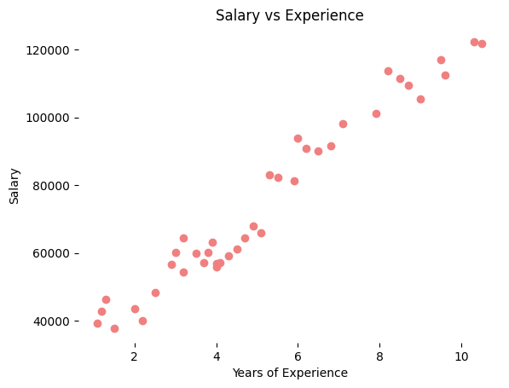
Project analysis slide 10
RELATIONSHIP BETWEEN SALARY AND EXPERIENCE USING SCATTER PLOT
The linear regression analysis revealed that as experience years increase, salary levels tend to rise proportionally.
POSITIVE CORRELATION :The correlation coefficient is 0.98 which implies a strong positive correlation between experience years and salary.
VARIABILITY AND OUTLIERS: There were rarely instances where points deviate from the main cluster.

Slide 8
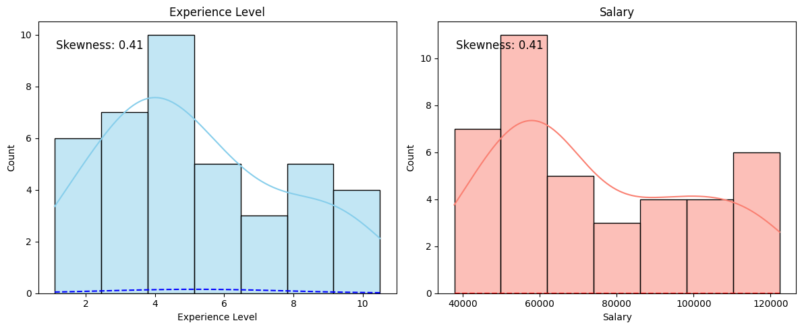
Project analysis slide 10
EXPLORING SKEWED DISTRIBUTION OF EXPERIENCE LEVEL AND SALARY
Years Of Experience Distribution: Years of experience appear to be relatively evenly spread, with a slight concentration towards lower experience levels.
Salary Distribution: The majority of data points cluster around lower salary values, with a smaller number of data points representing higher salary levels. The distribution of salaries is right-screwed, suggesting that there are more instances of lower salaries compared to higher salaries in the dataset.

Slide 9
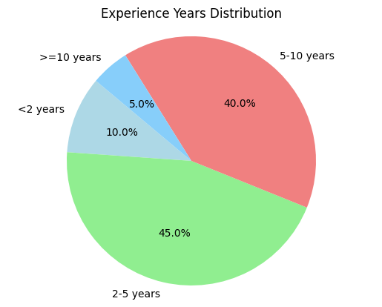
DISTRIBUTION OF YEARS OF EXPERIENCE
A large percentage(45%) of the population has between 2 to 5 years of ExperienceAbout 40% of the population has between 5 to 10 years of Experience
About 10% of the population has a population of less than 2 years of experience while about 5% has experience of 10 years and above
.

Slide 10
ANALYSIS:
Out of the 40 employees in the dataset,25% have an experience level equal to or less than 3.2 years, and their salaries are at or below $56,878.25.
75% of employees in the dataset have an experience level equal to or less than 6.8 years, and their salaries are at or below $95,023.25
Range:
The least paid employee's minimum experience years is 1.10 years with the minimum salary of $37,731.00, and the maximum is $122,391.00 with 10.5 years experience, reflecting a wide range of compensation levels across individuals in our dataset
Display summary statistics for numerical variables TISTICS
 | Experience Years | Salary
count | 40.00 | 40.00
mean | 5.10 | 74743.60
std | 2.65 | 25947.15
min | 1.10 | 37731.00
25% | 3.20 | 56878.20
50% | 4.60 | 64472.50
75% | 6.80 | 95023.20
max | 10.50 | 122391.00

Slide 11

FINDINGS FROM THE MODEL PERFORMANCE EVALUATION AFTER TRAINING AND TESTING

Slide 12
PERFORMANCE METRICS
Mean Absolute Error (MAE) | R-squared | Mean Squared Error (MSE) | Root Mean Squared Error (RMSE)
Accuracy measurement of the model | Coefficient of determination |  | Metrics for accuracy measurement
4539.73 | 0.83 | 31765611.21 | 5636.1
MAE = (1/n) * Σ|yi – xi| | R2=1−SST/SSE​ | MSE = (1/n) * Σ i( xi- yi ² | RMSE = √[ Σ(P_{i} – O_{i})² / n ]
Average absolute difference between the predicted values and the actual values in the dataset. | Proportion of the variance for a dependent variable explained by an independent variable | Average squared difference between the predicted values and the actual values in the dataset. 90 | The square root of the MSE
High | Excellent | Too high | High

Slide 13
FINDINGS
The coefficient of 9509.87 indicates that, on average, each additional year experience is associated with an increase in salary of approximately $9509.87.
The intercept of 26124.98 represents a constant- the base salary (or starting salary) for individuals with zero years of experience
R squared is 0.83 which implies 83% of the variance in the dependent variable (salary) that is explained by the independent variable (experience years).
Mean Absolute Error (MAE): The MAE which is the average absolute difference between the predicted salaries and the actual salaries in the dataset is 4539.73

Slide 14
RECOMMENDATIONS
The high R-squared value of 0.83 suggests that the model has a good explanatory power of the variables.
Improvement in the model's predictive
A limited sample size of 40 observations could have led to high biases and inaccuracies. Increase the observations
13

Slide 15
RECOMMENDATIONS(CONTD)
Incorporating additional variables like geographical location, department/role etc. will improve the explanatory power of the predictive variables.
Heteroscedasticity should be reduced.
14

Slide 16
LINES OF CODES aND THEIR FUNCTIONS MPORT LIBRARIES import pandas as pd # data manipulation import numpy as np # numerical computing import matplotlib.pyplot as plt # data visualization import seaborn as sns #data visualization from sklearn.model_selection import train_test_split # split a dataset into two subsets from pandas.core.common import random_state # generating random numbers or shuffling data from sklearn.linear_model import LinearRegression #modeling the relationship between a dependent variable and one or more independent variables

Slide 17
#Read the file and check the first 2 rows df=pd.read_csv(r'https://raw.githubusercontent.com/ybifoundation/Dataset/ main/Salary%20Data.csv') df.head(2) Display data types of each column df.dtypes # Display summary statistics for numerical variables df.describe().round(2) # Display the shape of the DataFrame print(df.shape) # Check for missing values print(df.isnull().sum()) # Check for duplicate rows duplicate_rows = df[df.duplicated()].sum() duplicate_rows

Slide 18
#check column headers df.columns from scipy.stats import norm, skew #Calculate skewness experience_skew = skew(df["Experience Years"]) salary_skew = skew(df["Salary"]) # Plot histograms and normal distribution curves fig, axes = plt.subplots(1, 2, figsize=(12, 5)) sns.histplot(df["Experience Years"], kde=True, color='skyblue', ax=axes[0]) sns.histplot(df["Salary"], kde=True, color='salmon', ax=axes[1]) # Calculate the correlation coefficient correlation = df['Experience Years'].corr(df['Salary']) print("Correlation coefficient between experience and salary:", correlation)

Slide 19
# Add normal distribution curve x_exp = np.linspace(min(df["Experience Years"]), max(df["Experience Years"]), 100) x_sal = np.linspace(min(df["Salary"]), max(df["Salary"]), 100) axes[0].plot(x_exp, norm.pdf(x_exp, np.mean(df["Experience Years"]), np.std(df["Experience Years"])), color='blue', linestyle='--') axes[1].plot(x_sal, norm.pdf(x_sal, np.mean(df["Salary"]), np.std(df["Salary"])), color='red', linestyle='--') # Add skewness values axes[0].text(0.05, 0.9, f'Skewness: {experience_skew:.2f}', transform=axes[0].transAxes, fontsize=12) axes[1].text(0.05, 0.9, f'Skewness: {salary_skew:.2f}', transform=axes[1].transAxes, fontsize=12) # Set titles and labels axes[0].set_title('Experience Level') axes[1].set_title('Salary') axes[0].set_xlabel('Experience Level') axes[1].set_xlabel('Salary') plt.tight_layout() plt.show()

Slide 20
# Pie chart to show distribution of years of experience
labels = ['<2 years', '2-5 years', '5-10 years', '>=10 years']
sizes = [len(df[df['Experience Years'] < 2]),
len(df[(df['Experience Years'] >= 2) & (df['Experience Years'] < 5)]),
len(df[(df['Experience Years'] >= 5) & (df['Experience Years'] < 10)]),
len(df[df['Experience Years'] >= 10])]
colors = ['lightblue', 'lightgreen', 'lightcoral', 'lightskyblue']
plt.pie(sizes, labels=labels, colors=colors, autopct='%1.1f%%', startangle=140)
plt.title('Experience Years Distribution')
plt.axis('equal')
plt.show()
# Relationship between Salary and Experience
plt.scatter(df['Experience Years'], df['Salary'], color='lightcoral')
plt.title('Salary vs Experience')
plt.xlabel('Years of Experience')
plt.ylabel('Salary')
plt.box(False)
plt.show()

Slide 21
# Splitting variables
X = df[['Experience Years']] # independent variable(s)
y = df['Salary'] # dependent variable
# Splitting dataset into test/train
X_train, X_test, y_train, y_test = train_test_split(X, y, test_size = 0.2, random_state = 0)
# Creating and fitting the linear regression model
regressor = LinearRegression()
regressor.fit(X_train, y_train)
from sklearn.metrics import r2_score, mean_squared_error,mean_absolute_error
# Evaluate model performance
y_pred = regressor.predict(X_test)
r2 = r2_score(y_test, y_pred)
mse = mean_squared_error(y_test, y_pred)
rmse=np.sqrt(mse)
mae = mean_absolute_error(y_test, y_pred)

Slide 22
print("Mean Absolute Error (MAE):", mae.round(2))
print("R-squared:", r2.round(2))
print("Mean Squared Error:", mse.round(2))
print("Root Mean Squared Error:", rmse.round(2))
# Make predictions on new data
new_data = [[5.0], [6.0]] # Example: predicting salaries for individuals with 5 and 6
years of experience
predicted_salaries = regressor.predict(new_data)
print("Predicted salaries:", predicted_salaries.round(2))

Slide 23

THANK YOU
RETAIL ANALYTICS(GROUP 4)
ECONOMICS DEPARTMENT,
UNIVERSITY OF WEST GEORGIA
aomogbe1@my.westga.edu
em00052@my.westga.edu
conoh1@my.westga.edu

